Slide 1
Audience Analysis

Slide 2

The Importance of Audience Analysis
Audience centeredness: “Keeping the audience foremost in mind at every step of speech preparation and presentation” (Lucas, 2012, p. 98).
Targeted messages must be created and fine-tuned for your particular audience
Identification (the common bond between speaker and audience) can be created through targeted messages (Kenneth Burke, A Rhetoric of Motives, 1950)

Slide 3
Demographic Audience Analysis Method
Step 1: Identify general demographic features of your audience
Step 2: Determine the importance of those features to the speaking situation
Avoid stereotyping—assuming all members of a group are the same
Demographic analysis is a starting point for gauging audience interests, beliefs, values, etc.

Slide 4
Demographic Audience Analysis Variables
Age
Gender
Sexual orientation
Racial, ethnic and cultural background
Religion
Group membership
Other variables

Slide 5
Dispositional Audience Analysis Methods
Interviewing
Questionnaires
Focus Groups

Slide 6

Dispositional Audience Analysis Variables
Interests
Knowledge
Attitudes
Motivations
  Maslow’s Hierarchy of Needs

Slide 7
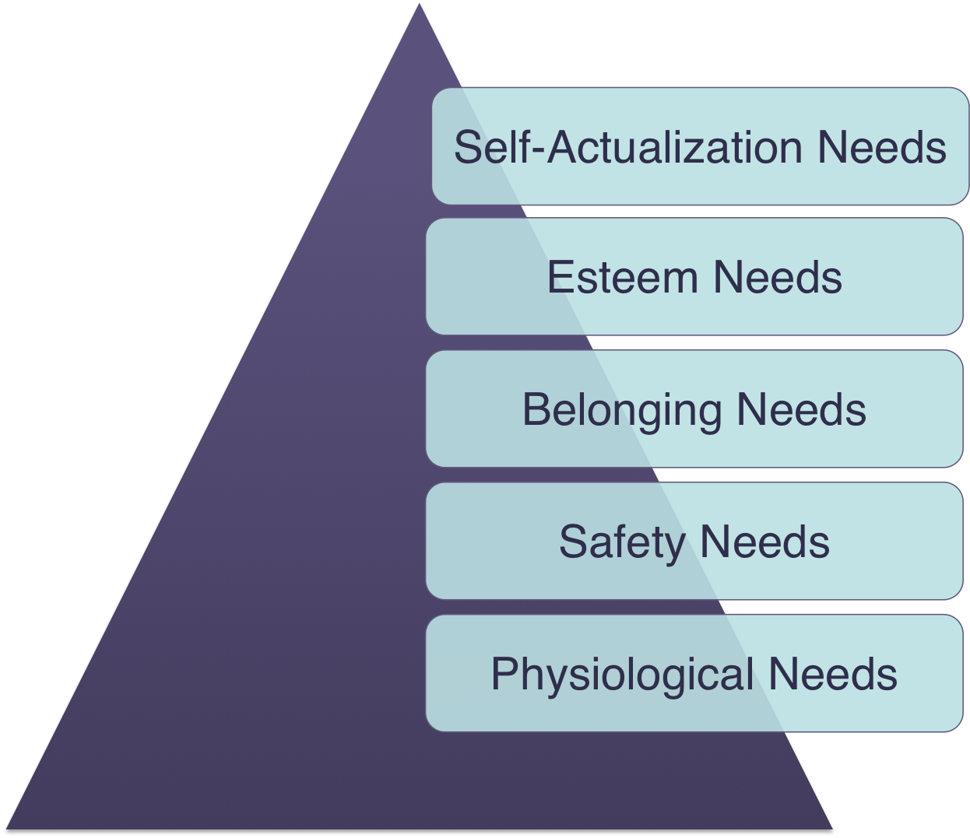

Slide 8
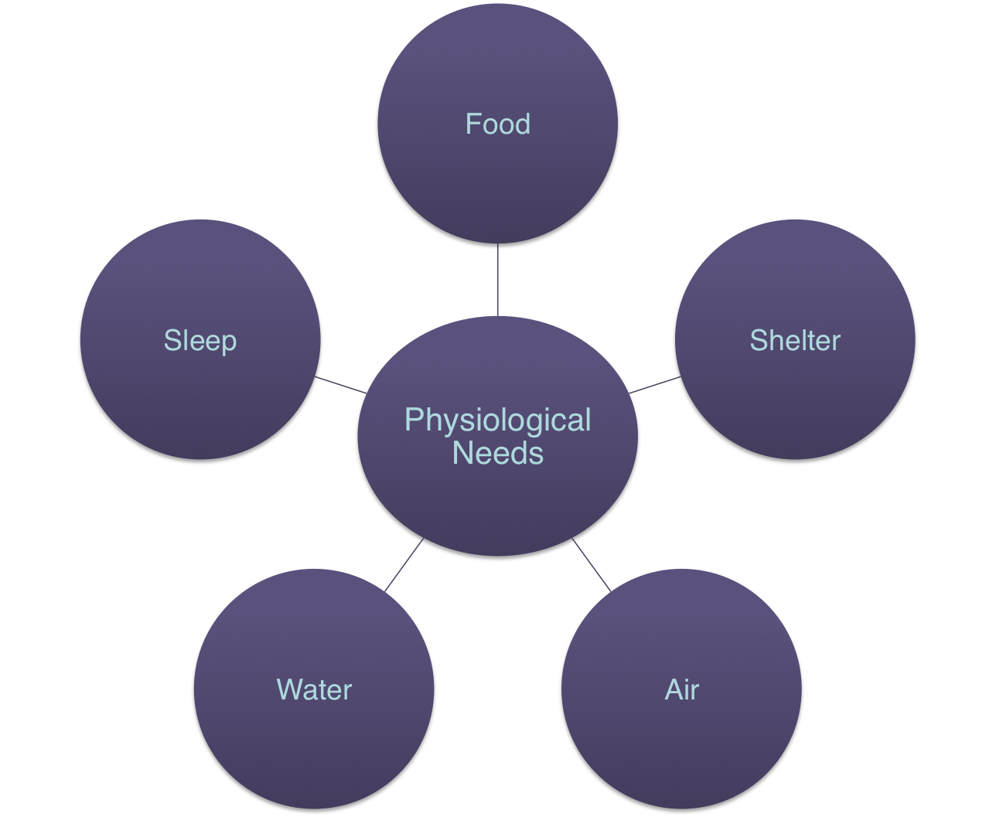

Slide 9
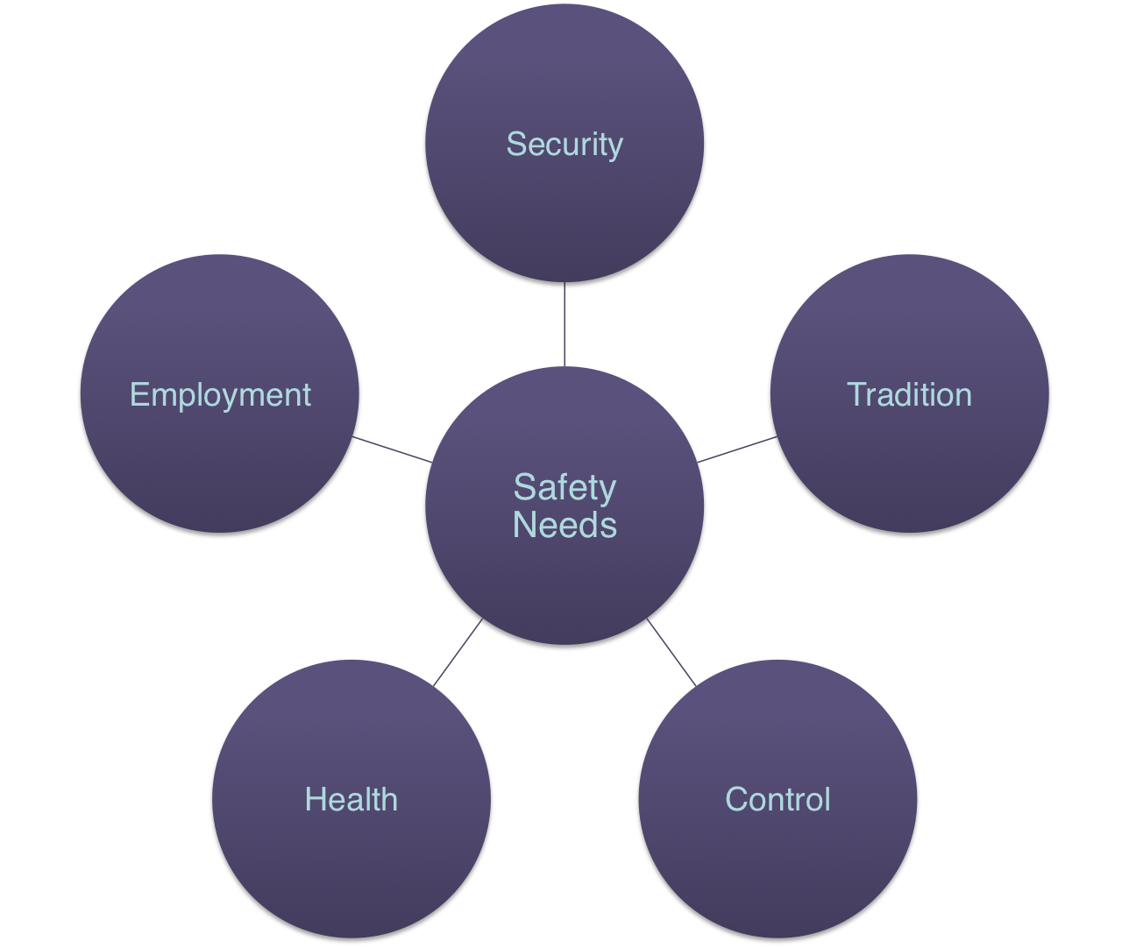

Slide 10
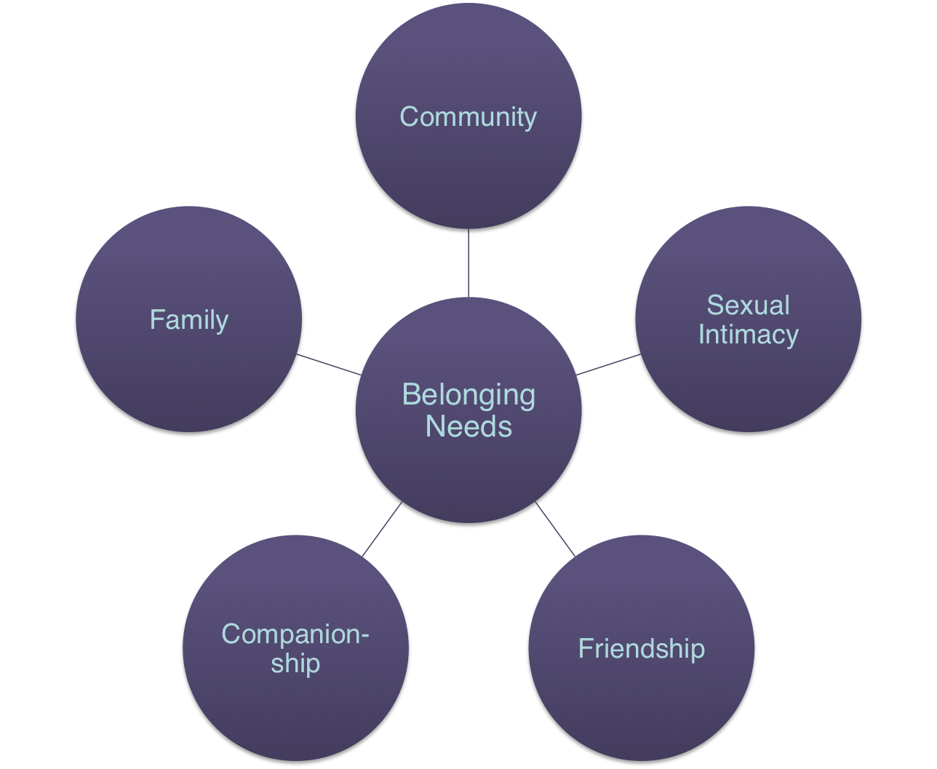

Slide 11
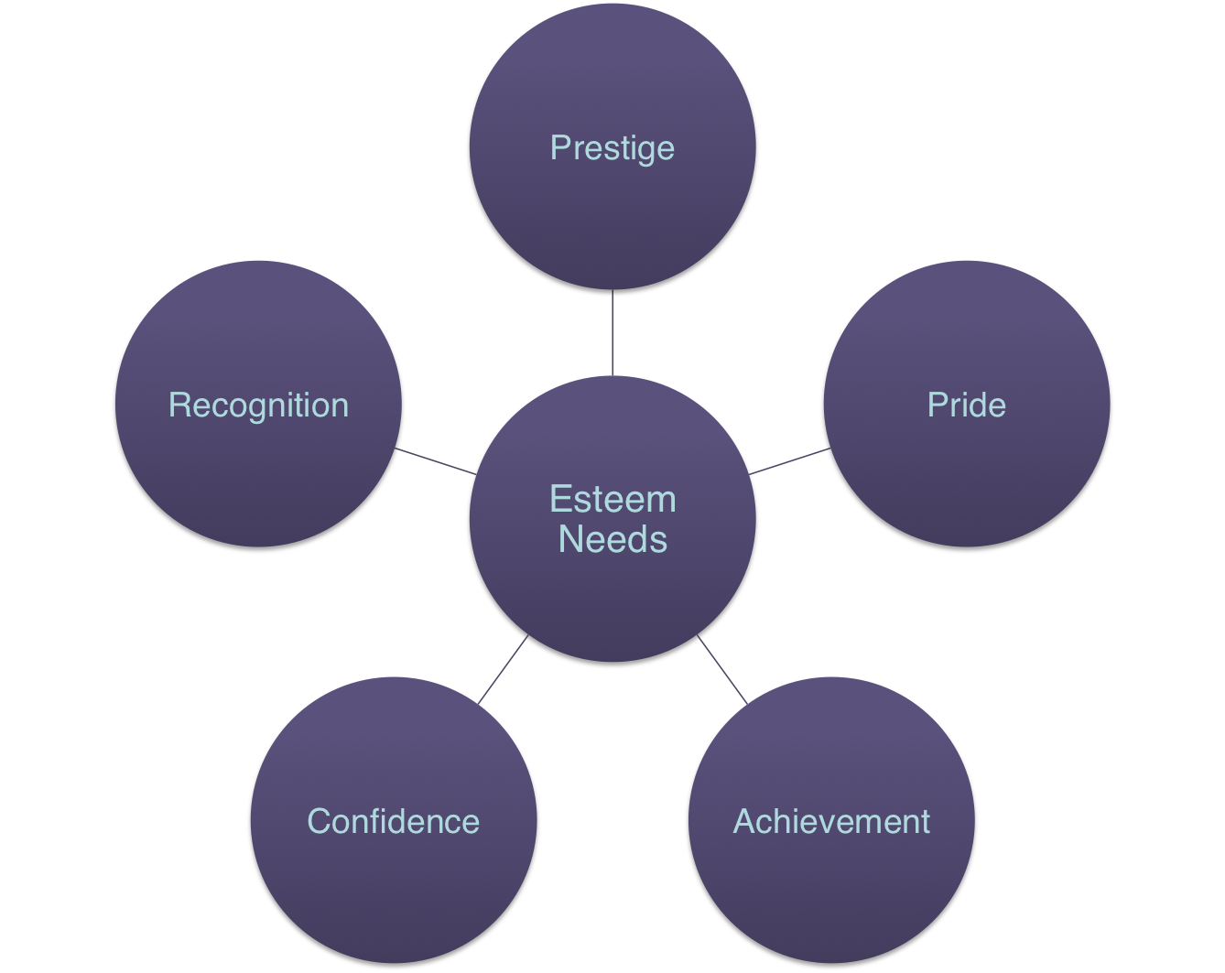

Slide 12
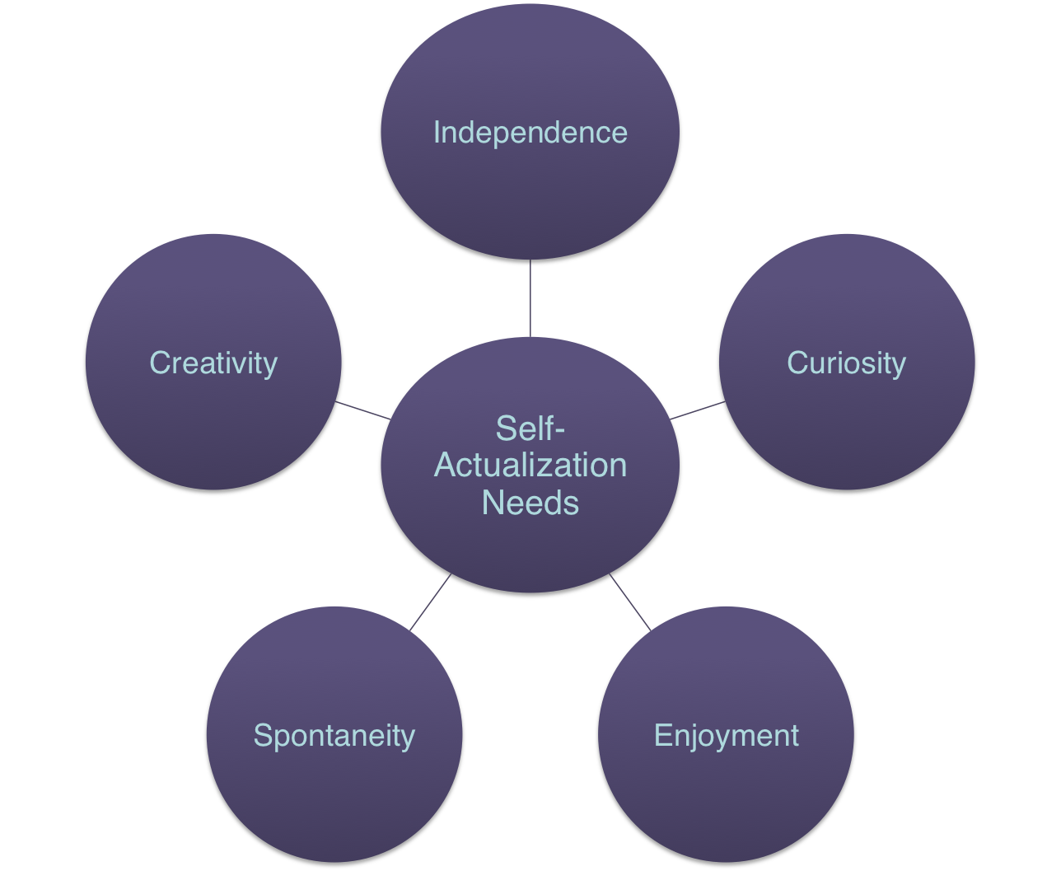

Slide 13
Ford Taurus--Resume
I’ve been named a “Best Pick” by the Insurance Institute for Highway Safety.
My lower anchors and tethers for children (LATCH) system is a safe and easy way to install child safety seats.
My emergency trunk release is visible to anyone who may have accidentally become trapped inside.

